Slide 1
COVID-19 (SARS-CoV-2) & Bloodborne Pathogens (BBP)
Protecting Yourself from
Infectious Diseases
Mario Majette, MD, MPH
Introduction to Clinical Medicine
University of Maryland School of Medicine
June 19, 2020

Slide 2
Juneteenth
Holiday !!!
Celebration !!!
The actual day is not as important as the idea…

Slide 3
Juneteenth
Juneteenth is the oldest nationally celebrated commemoration of the ending of slavery in the United States. Dating back to 1865, it was on June 19th that the Union soldiers, led by Major General Gordon Granger, landed at Galveston, Texas with news that the war had ended and that the enslaved were now free.
Note that this was two and a half years after President Lincoln’s Emancipation Proclamation - which had become official January 1, 1863. The Emancipation Proclamation had little impact on the Texans due to the minimal number of Union troops to enforce the new Executive Order. However, with the surrender of General Lee in April of 1865, and the arrival of General Granger’s regiment, the forces were finally strong enough to influence and overcome the resistance.
https://www.juneteenth.com/history.htm

Slide 4

National Museum of African American History and Culture
15th St. and Constitution Ave., NW Washington, DC

Slide 5
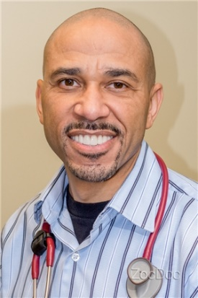
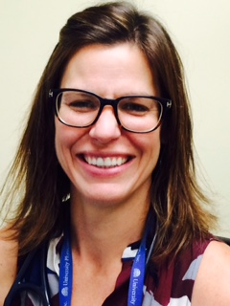
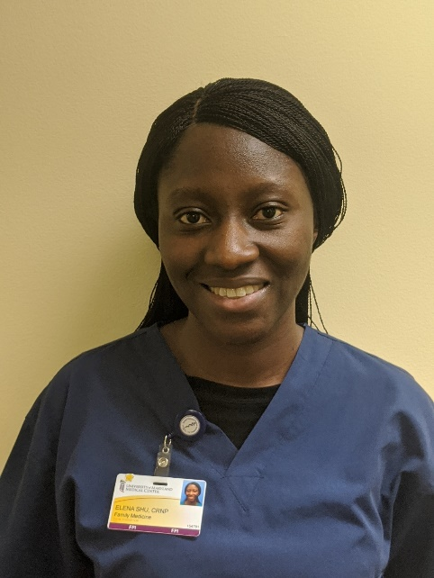

Student Health Providers
Mario Majette, MD, MPH
Sarah Sampson, CRNP
Elena Shu, CRNP
Niharika Khanna, MD
Medical Director of Student & Employee Health
Associate Director of Student & Employee Health
Our goal is for students to see UMIC and the student health team as their health care home

Slide 6
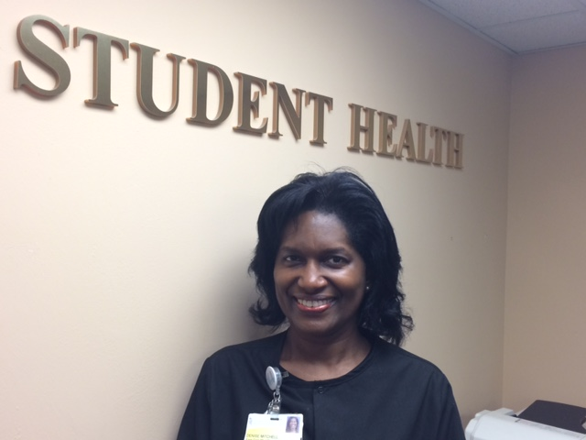
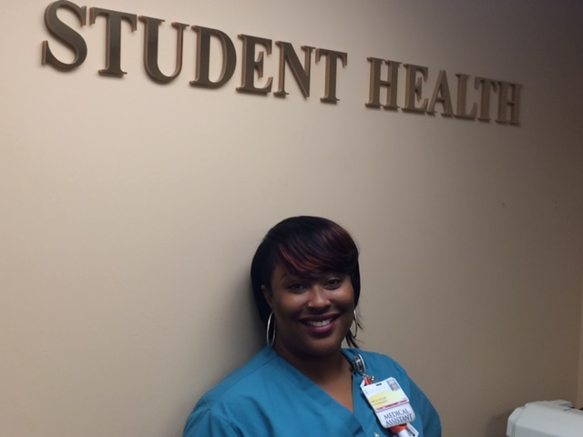
Student Health Administrative Team
Denise Mitchell, MA
Student Health Coordinator
Akila, Taylor, MA

Slide 7
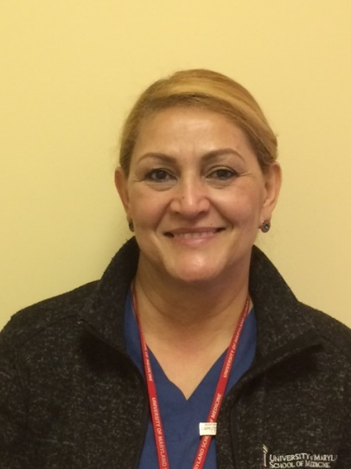
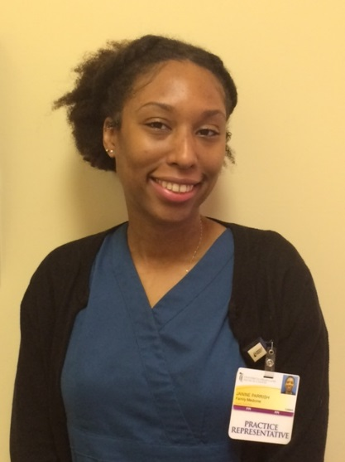
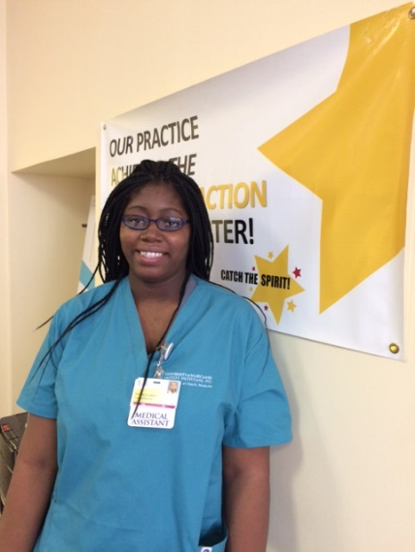
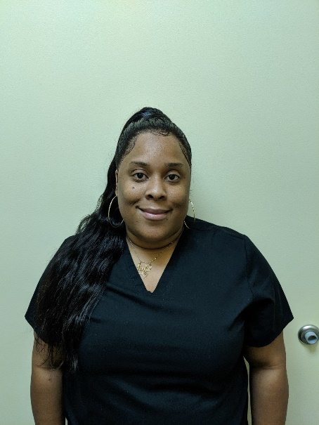
UMIC Care Team
Elena Hernandez-Torres, Medical Practice Representative
Janine Parrish, Medical Practice Representative
Patrice Gray, MA
Shakieta Adams, MA

Slide 8
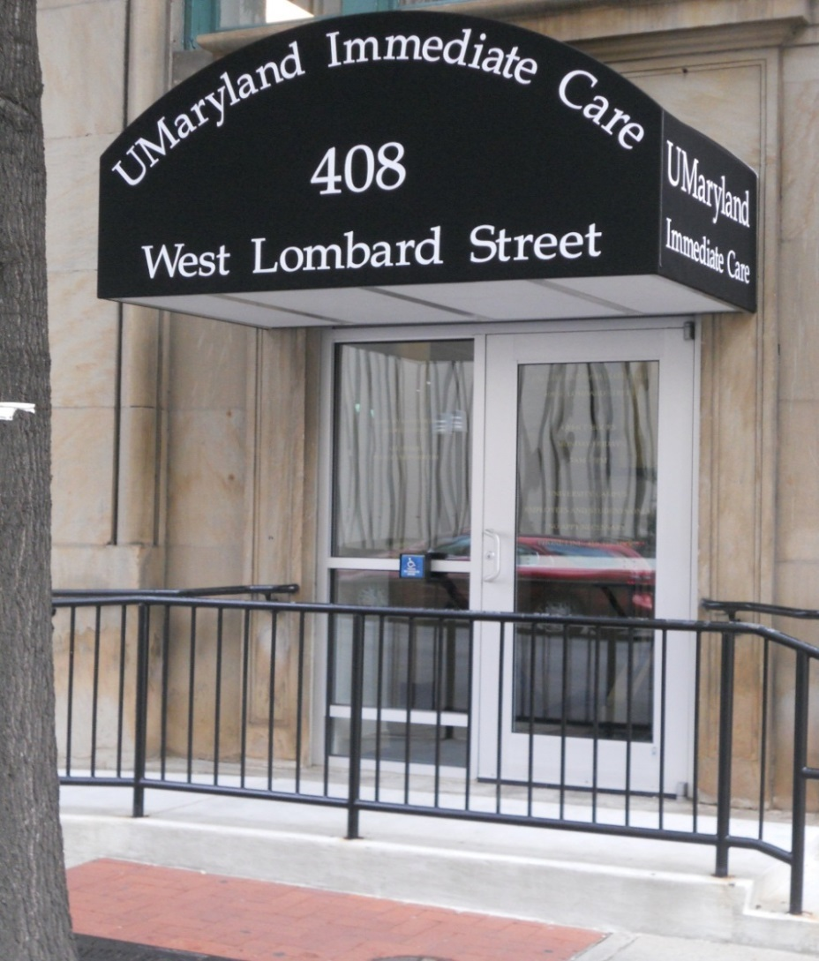
Where are we?
408 W Lombard Street
* By scheduled appointment *
Upper Level – Immediate Care
Mon – Fri (7:00a – 4:30p)
(667) 214 – 1899
Lower Level – Student Health Administrative Office
Mon – Fri (8:30a - 4:30p) (667) 214 – 1847
shealth@som.umaryland.edu

Slide 9
My Personal Pandemic Goal
A “Symptom-Free Campus”
This is what is going to keep all of US and our families safe.
This demonstrates the love that we have for our patients and our communities.
A healthy workforce is essential to our success.
We need a change in our work culture.
Coming to work sick should not be rewarded or branded as being “tough” or “someone who never gives up.”
Policies that are not punitive.
A kinder-gentler campus environment.

Slide 10
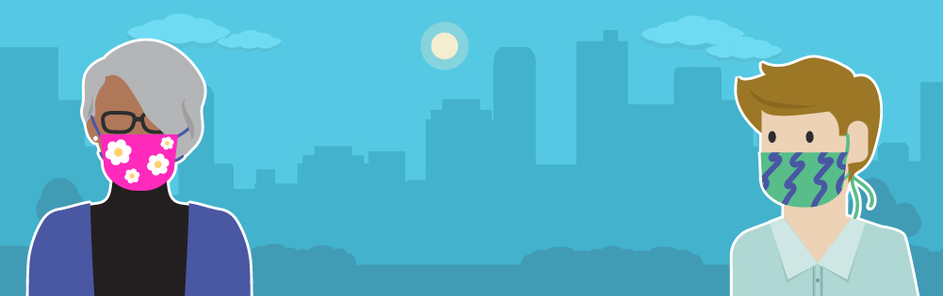
Show the Love…
Your cloth face covering may protect them. Their cloth face covering may protect you.
https://www.cdc.gov/coronavirus/2019-ncov/prevent-getting-sick/diy-cloth-face-coverings.html

Slide 11
4 key tools to protect YOURSELF against infectious harm
Hand hygiene
Enhanced Standard Precautions
Transmission-based Precautions
Injection safety

Slide 12
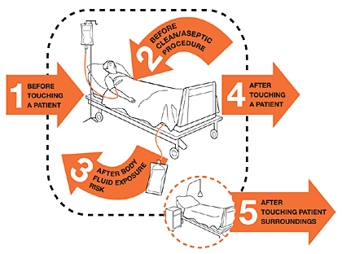
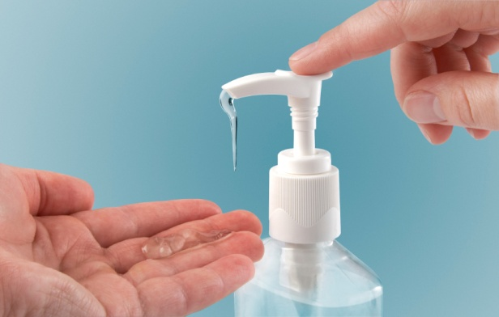
Hand Hygiene
Single Most Important Infection Prevention Intervention

Slide 13
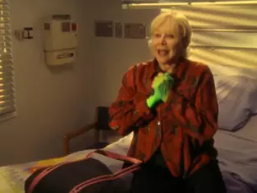
Keys to Preventing Transmission
Hand Hygiene
Transmission-based Precautions
https://www.youtube.com/watch?v=VK2vpOh5wws

Slide 14

“Enhanced” Standard Precautions
Mask
Eye Protection
UMMS Student Clinical Rotation Policy

Slide 15
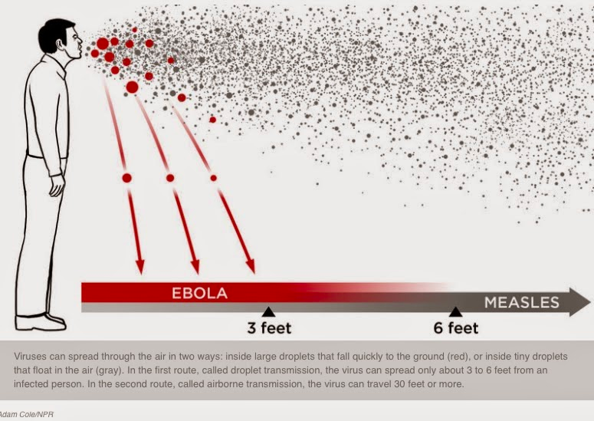
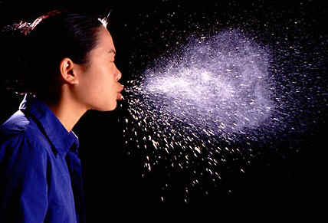
DROPLET
AIRBORNE

Slide 16
PPE
Personal Protection Equipment (PPE)
For COVID-19:
Respirator (N95 or equivalent)
Eye Protection
Gown
Gloves
UMMS Student Clinical Rotation Policy

Slide 17
Respiratory Protection
Cloth Mask
Surgical Mask (ear loop)
N95
Elastomeric Respirator
PAPR (Powered Air Purifying Respirator)

Slide 18
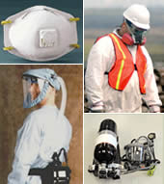
Types of Respirators

Slide 19
Types of Respirators
Respirator Overview
Air Purifying = N95, elastomeric, PAPR
Tight fitting
Loose fitting
Air Supplying = SCBA – self-containing breathing apparatus
Tight fitting
Loose fitting

Slide 20
N95 Respirator
N95:
Air purifying, tight fitting, “disposable” respirator
N = not resistant to oil
R = somewhat resistant to oil
P = oil-proof
Blocks 95% of particulate matter
Seal – key to effectiveness
Fit Testing (mask specific) ***
Not gases or vapors (nonparticulate)

Slide 21
“Enhanced” Cleaning/Disinfecting
EPA approved agents against SARS-CoV-2
https://www.epa.gov/coronavirus/disinfectant-use-and-coronavirus-covid-19
https://www.epa.gov/pesticide-registration/list-n-disinfectants-use-against-sars-cov-2-covid-19
High-touch Surfaces
Doorknobs
Light switches
Faucet handles
Pens
Phones
Etc.

Slide 22
CDC COVID-19 Case Definition (current)
Symptoms may appear 2-14 days after exposure to the virus. People with these symptoms may have COVID-19:
Fever or chills
Cough
Shortness of breath or difficulty breathing
Sore throat
Fatigue
Muscle or body aches
Headache
New loss of taste or smell
Congestion or runny nose
Nausea or vomiting
Diarrhea

Slide 23
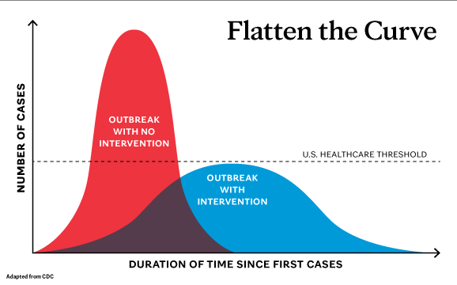
Bending the Curve
https://newsnetwork.mayoclinic.org/discussion/covid-19-flattening-the-curve/

Slide 24
UMMS Student Clinical Rotation Policy

Slide 25
Student Health Attestation For COVID-19
The UMB campus and your schools have put measures in place to help reduce your risk of contracting COVID-19. However, as a student that participates in on-campus learning, I understand there is a risk of acquiring COVID-19 within the campus setting.
As a University of Maryland Baltimore student, I agree:
I will practice physical distancing while on campus.
I will practice appropriate hand hygiene.
I will wear a mask while inside all UMMS facilities at all times.
I will wear a mask and eye protection during patient care encounters.
I am aware that I cannot participate in the direct in-person care of any known or suspected COVID-19 patient/client.
I will monitor myself and report any COVID-19 symptoms to the Hotline 1-800-701-9863.
(Student Health will be notified of your hotline call, and a representative will contact you with further instructions)
Symptoms include: fever > 100.0 F, sore throat, new cough, trouble breathing, congestion or runny nose, headache, new onset/change in taste or smell, nausea or vomiting, diarrhea, body aches, fatigue
I will report any international travel to the COVID-19 Hotline: 1-800-701-9863
I will report any known community/campus exposure to the COVID-19 hotline: 1-800-701-9863
I will report if I have been tested for COVID-19 by an off campus facility: 1-800-701-9863
I will not attend campus activities, in-person classes, clinical rotations, field placements or internships if requested to quarantine by a medical professional.
I understand that for medical/personal reasons I can ask to delay my return to clinical activities (such as taking a medical leave of absence). I also understand that taking leave could delay the completion of program requirements and graduation. Individual details should be discussed with the dean's office of your school.

Slide 26
Blood Borne Pathogens
The Usual Suspects…
HIV
HBV
HCV

Slide 27
HIV
Currently no vaccine.
HIV transmission does occur in occupational health settings:
-Risk is <1% in percutaneous injury.
-Risk of transmission of body fluids to eyes/mucus membranes even lower.
-Risk depends extent of exposure, needle size, amount of blood, etc.
HIV prophylaxis is AVAILABLE = PEP (Post Exposure Prophylaxis)
Time is of the essence! The sooner the better, but prophylaxis started up to 72hrs after exposure has demonstrated effectiveness in preventing infection.

Slide 28
Hepatitis B
Treatment is supportive.
-Less than 1% results in liver failure.
-Less than 5% results in chronic infection.
Great news! We have a vaccine to prevent it!
*If your titer shows immunity you are IMMUNE.
So, if a Hep B Exposure occurs:
You are immune and nothing further needs to be done concerning Hep B.
If not immune at time of exposure you will be referred for ID consult and a decision made on whether you need to be sent to the Emergency Room for prophylaxis.
Risk is 6-30% from a single needle stick/cut exposure.

Slide 29
Hepatitis C
Currently there is no vaccine for Hepatitis C.
An acute HCV infection can spontaneously clear on its own, this is called spontaneous viral clearance.
-This occurs in 15-25% of those infected.
Chronic HCV responds well to antiviral therapy.
Hepatitis C transmission does occur in occupational health settings.
-Risk is 0.2% for percutaneous (sharps/needlesticks) injuries.
-There are a few reported cases of transmission from eye splashes.
-There is no accepted HCV post exposure prophylaxis.

Slide 30
BBP - Types of Exposures
Parenteral inoculation - needle stick / sharps
Eye splashes - patient blood, saliva, wound debris
Bites
*The potential risk of infection is dependent on type and details of the exposure

Slide 31
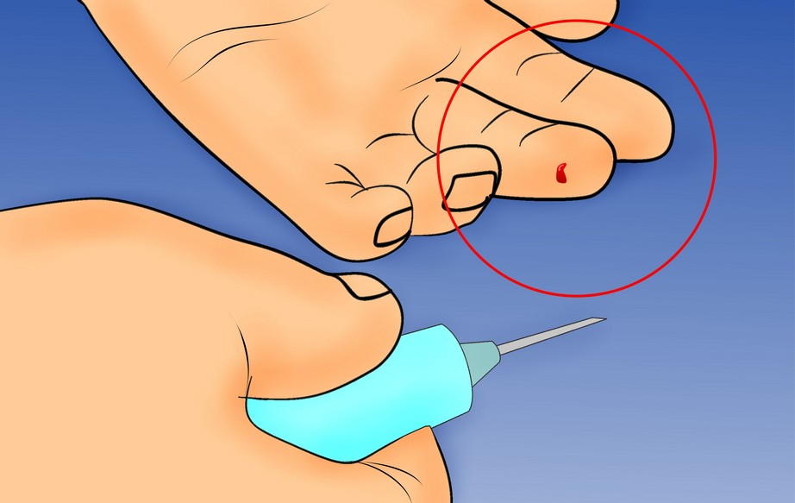
Sharps Injuries – Needlesticks
~ 385,000 needlesticks per year
More than 1000 each day
Most Injuries occur in
OR (27%) or Patient Room (39%)
NaSH June 1995—December 2003 (n=23,197)
Notes:
Sharp injuries may occur in up to 15% of cases
Suture needle injuries are most common
16% of injuries occur while passing sharps

Slide 32
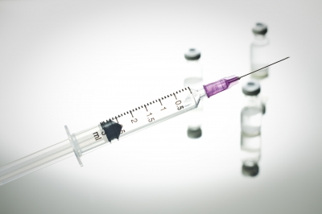
Key Points – Protect Yourself Avoid needle sticks
Be prepared
Be aware
Dispose with care
Protect your self
Protect your patient

Slide 33
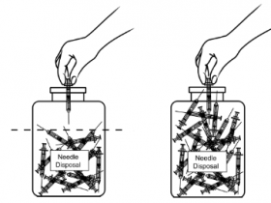
Protect Yourself
Keep sharps pointed away from user
Know where disposal container is
Know the situation – e.g. is pt cooperative
Keep your eyes on the sharps
Neutral zones to place/retrieve (Do not pass!)
Verbalize placement of sharps
Activate any safety features
Do NOT recap needles
Active clean up

Slide 34
Question:
You are on your surgical rotation. The resident asks you to assist him during a suturing procedure, which happens on a Friday overnight call. While he is passing you the needle he used for the local anesthesia, you feel a sharp pain and realize that the needle has punctured your glove. Following this injury, what is the most appropriate way to get in touch with the appropriate resources?
Call your resident
Call UMSOM Student Health (667-214-1886)
Call the Needlestick Hotline (410.328.BEEP then enter STIK)
Call the Infection Control office (410.328.5757)
Call the employee health office to report the injury on Monday
Notes:
C is the correct answer because that is the needlestick hotline number. E is not correct because employee health office is not open in the middle of the night.

Slide 35
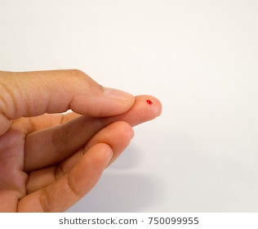
Exposure Protocol (for needle sticks or other BBP exposures)
24/7 Stick hotline: 667-214-1886
http://www.umaryland.edu/studenthealth/urgent-needs/blood-borne-pathogens-exposure/
If during regular UMIC hours (M-F 7-5p), call office ahead for an evaluation.
If after hours or when in doubt, use the hotline above to speak with a provider.
Student Health will arrange for an exposed student to be seen ASAP if needed.
We will discuss risks, options and recommendations.
We will prescribe HIV post-exposure medications when appropriate.
We will arrange for any recommended blood testing for you / source patient .
Students on away rotations or outside of the downtown Baltimore campus should familiarize themselves with that site’s/facility’s exposure procedure - but again, when in doubt call the 24/7 hotline above.

Slide 36
Blood Borne Pathogens
https://www.umaryland.edu/studenthealth/urgent-needs/blood-bourne-pathogens-exposure/
Hotline is active: 24 hours a day
Hotline number: 667-214-1886

Slide 37
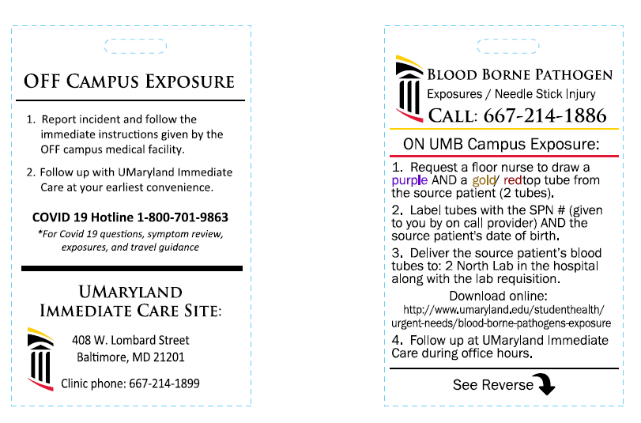
New Exposure Tags

Slide 38
Source Patient
Source patient blood needs to be drawn – follow protocol
The lab will result the HIV test within 60-90 minutes.
The Hep B and C results will come back within 24 hrs.
If exposure occurs during regular business hours the student can be directed to UMIC for immediate evaluation and possible treatment.
Not all exposures require treatment.
You should know your own HBV status = Immune/Not Immune
Follow-up with Student Health/UMIC for monitoring.

Slide 39
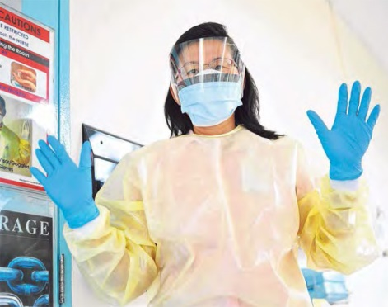
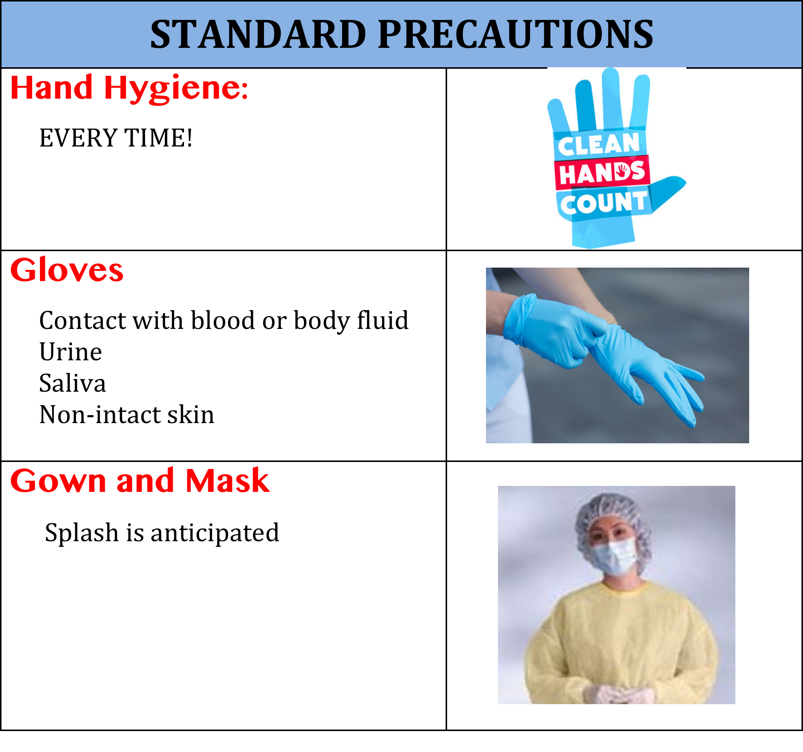
General Tips for Prevention
Notes:
1. Hand hygiene ever time
2. Gloves for contact with blood or body fluid potentially contaminated with blood – including urine, saliva and non-intact skin
3. Gown and mask if splash is anticipated

Slide 40
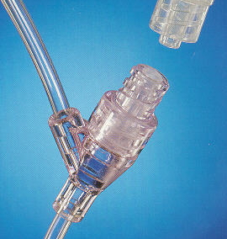
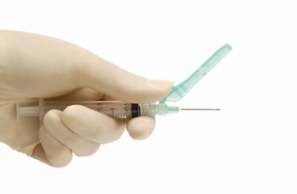
Engineering Protection
DO NOT USE needles!
Needleless systems whenever possible
DO USE devices with built in safety features

Slide 41
Key Points – Protect Yourself After the needle stick
Immediately
Wash injury
Report Injury
8-BEEP; STIK
Students: 667-214-1886
Protect your self
Protect your patient

Slide 42
Key Points – Injection Safety
Needles and syringes are always single use
Do not use single dose vials for >1 patient
All IV bags are single use
Limit use of multidose vials
Use for single patient when possible
Protect your patient
Protect your self

Slide 43
Responsible Parties
Mario Majette, MD
Alex Kaysin, MD
Sarah Sampson, CRNP
UMIC providers
available 24/7 for emergencies by phone: STICK line (667) 214-1886
available for in-person evaluation at UMIC: Mon – Fri 7a - 5p , (667) 214 – 1899
YOU also have the responsibility to report an incident and follow the protocol to ensure your own safety.
Keeping a safe work/learning environment is a team effort!
When in doubt, find instructions, contact info, forms online 24/7:
https://www.umaryland.edu/studenthealth/urgent-needs/blood-bourne-pathogens-exposure/

Slide 44
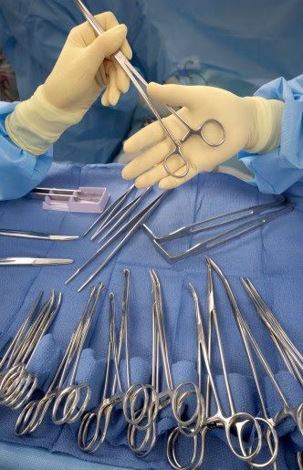
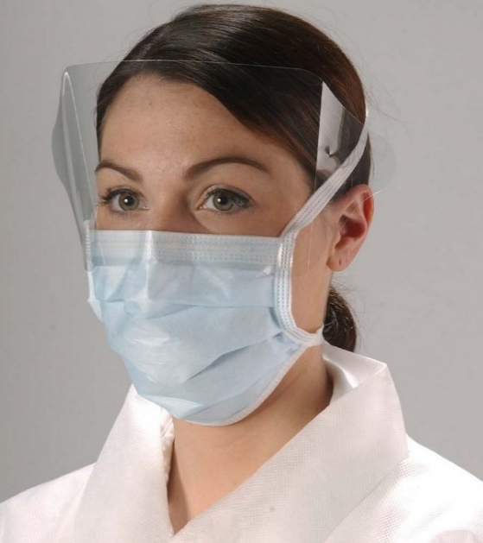
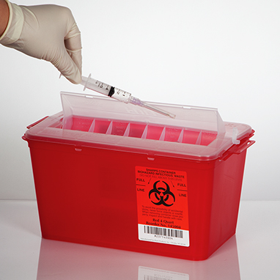
Staff Responsibilities
Clinical sites provide and train you on the the proper and consistent use of personal protective equipment
Provide a non punitive atmosphere that encourages reporting exposures
Provide a healthcare provider to be available 24/7 for exposures
Educate students on bloodborne infections and post exposure prophylaxis

Slide 45
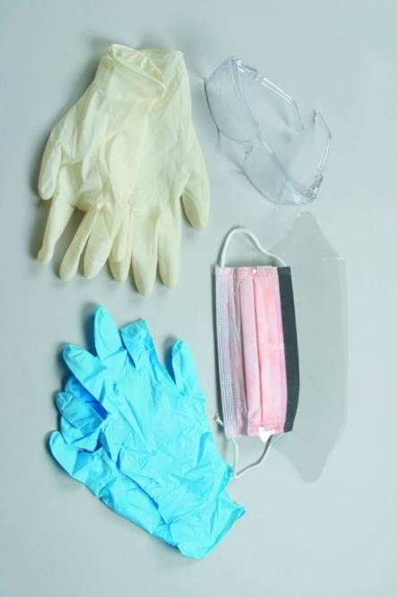
Preventative Strategies
Adherence to standard safety practices / techniques
Use proper universal precautions : treat all human body fluids as if known to be infectious of blood borne pathogens. Handle of all sharps with care and dispose properly.
Proper wear and use of PPE
Gloves, gowns, goggles, masks
Know and follow all on-site safety measures created to reduce the risk of exposure to infectious agents
Know who to contact in case of an injury or for questions/concerns. In general, you can follow the lead of your supervisors/instructors on site.

Slide 46
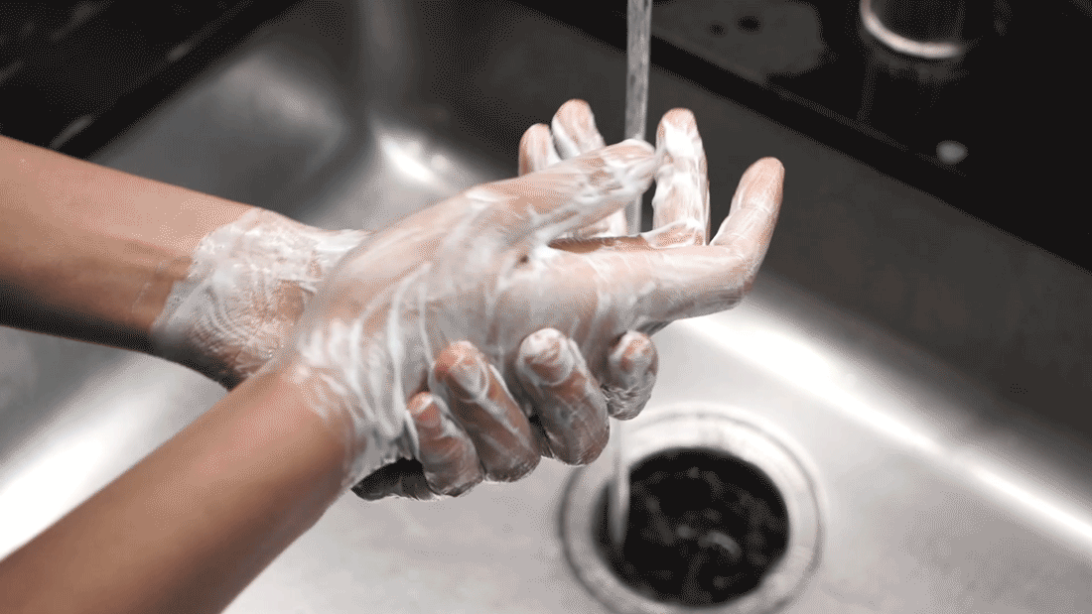
In the event of an exposure, or possible exposure:
1) Immediately stop what your doing.
2) Thoroughly wash the affected site.
3) Report it to your immediate supervisor.
4) Call the 24/7 needle stick hotline: (667) 214-1886
The type of exposure risk (low or high) and the results of source patient bloodwork will determine next steps:
-Nothing further
-Initial and serial testing (time of exposure, 4-6wks, 3mo)
-Post-exposure prophylaxis (PEP) treatment

Slide 47
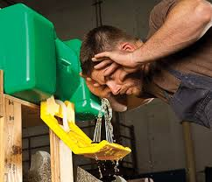
Reactive Strategies
-Wash the affected site with soap and water.
-No need to ‘bleed’ or ‘milk’ the site of exposure.
-Rinse thoroughly with water if exposure occurs at a mucous membrane (ex. nose, mouth).
If it’s an eye splash, go to your eye station and irrigate your eyes x 15min.

Slide 48
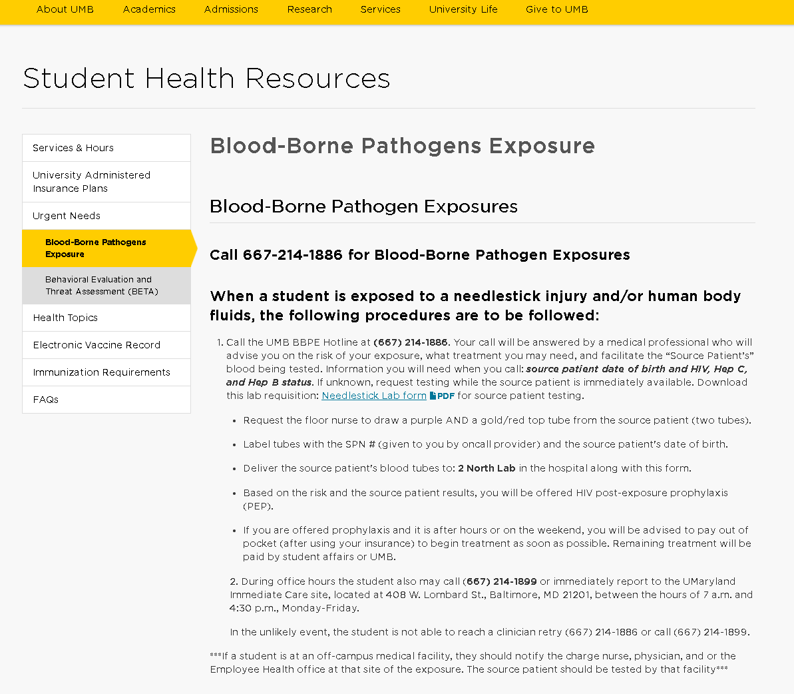
Reactive Strategies
Remember that all contact information, instructions and necessary forms can be found online 24/7 at: https://www.umaryland.edu/studenthealth/urgent-needs/blood-borne-pathogens-exposure/
Each off-campus site (not at the Baltimore downtown campus) has its own needle stick/blood borne pathogen exposure protocol.
Familiarize yourself with their protocol and the appropriate contact people/hotlines so you’ll know what to do in the case of an emergency at off campus rotations.
When in doubt, call us at UMIC or the needle stick hotline.

Slide 49
References
Biosafety in Microbiological and Biomedical Laboratories (BMBL) 4th edition. Available at : http://www.cdc.gov/of/ohs/biosfty/bmbl4/bmbl4s7e.htm
OHS safety manual at : http://www.cdc.gov/od/ohs/manual/mannav.htm
Mandell: Principles and Practice of Infectious Diseases, 5th ed.
http://www.cdc.gov/hepatitis/hcv/hcvfaq.htm
https://www.cdc.gov/hiv/workplace/healthcareworkers.html

